Slide 1
Layer-Selective INT8 Quantization of MobileNetV2 via Depthwise-Focused QAT
Jay Katyan, Neel Shejwalkar, Norman Zhang
12/08/2025

Slide 2
Agenda
Background on MobileNetV2
Problem & Motivation
Model Structure & System
Experiments
Results
Conclusions
Future Work

Slide 3
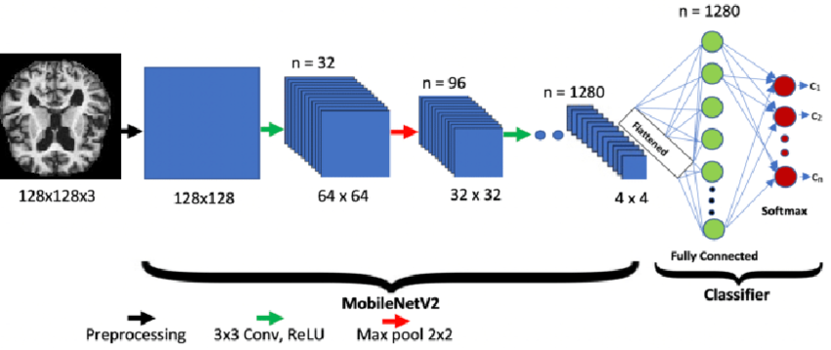
What is MobileNetV2?
Lightweight CNN designed for mobile and edge devices.
Uses inverted residual blocks (1x1 expansion -> 3x3 depthwise -> 1x1 projection).
Extremely compact with low redundancy, making it sensitive to model perturbations.
Widely used in real-time applications (vision on smartphones, robotics, embedded systems).

Slide 4
INT8 Quantization breaks MobileNetV2 in Critical Layers
Minimal redundancy (narrow layers + ReLU6 + bottlenecks) means that minor quantization noise in narrow bottleneck layers causes significant feature corruption.
Post-Training Quantization severely degrades accuracy, dropping to 44-68% in our experiments.
Depthwise convolutions are the main issue, lack cross-channel summation that cancels out quantization noise in standard CNNs.
Full Quantization-Aware Training (QAT) is accurate but requires 100% of parameters, computationally expensive and unnecessary for accuracy recovery.

Slide 5
Motivation: Layer-Selective QAT for Practical INT8 Deployment
INT8 models are 4x smaller and offer 2-4x faster CPU throughput, critical for mobile and real-time applications.
MobileNetv2 loses too much accuracy under Post-Training Quantization, rendering simple conversion methods unusable.
Full QAT restores accuracy, but requires retraining 100% of parameters, increasing training complexity, memory footprint, and deployment cost.
Quantization sensitivity is not uniform across the network, only small subset of layers (depthwise and 1x1 expansion) to restore most accuracy.
Goal: Determine minimal retraining scope needed to achieve full INT8 performance by applying QAT only to quantization-critical layers.

Slide 6
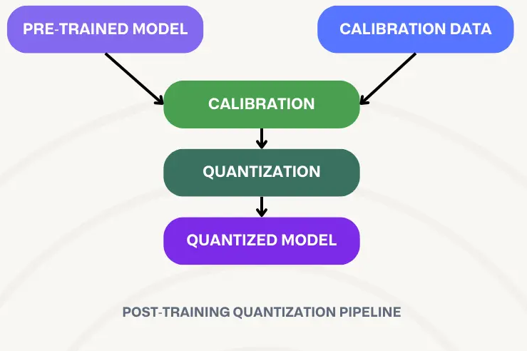
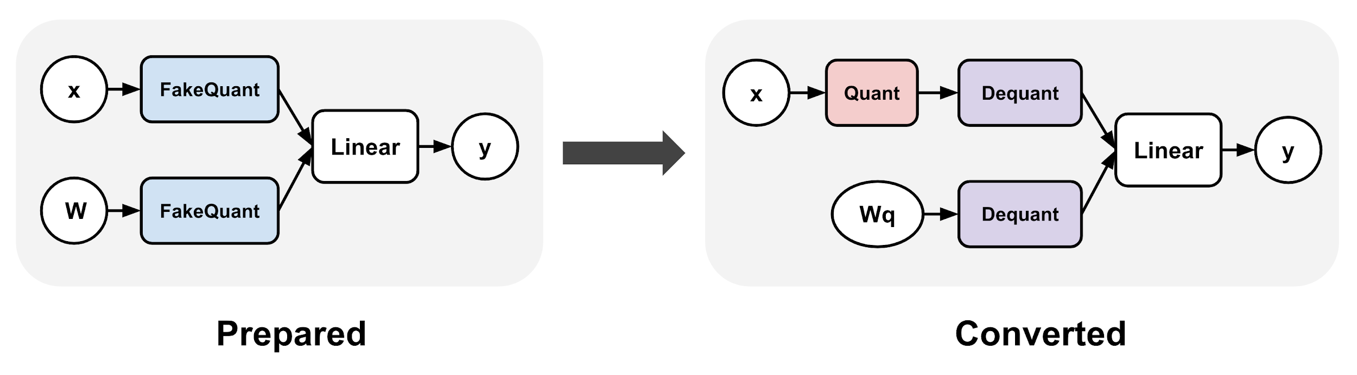
MobileNetV2 Model Structure and Quantization System
Model Structure:
Composed of 19 inverted residual blocks (1x1 expansion -> 3x3 depthwise -> 1x1 projection).
Uses bottlenecks and ReLU6, making activations narrow.
Processes 3 x 224 x 224 input images (CIFAR-10 resized) and outputs 10-class logits.
Post-Training Quantization System:
Converts FP32 weights/activations to INT8 without retraining, using global scale factors.
Quantization-Aware Training System:
Inserts fake-quant modules and learns quantization parameters during training to reduce FP32 -> INT8 mismatch
Quantization-Aware Training

Slide 7
Why MobileNetV2 Is Hard to Quantize
Bottleneck structure amplifies quantization noise
Narrow projection layers (e.g., 16 channels) have low redundancy.
Even small INT8 quantization noise corrupts the limited features.
Depthwise Convs prevent error averaging
Single-channel kernels mean errors do not cancel out across channels.
Weight quantization noise propagates 1:1 to the output
Introduces “mean shift” in activations that accumulates through layers
Extreme Variation in Activation Scales
Replaces ReLU6 point, scales vary very differently between channels
Standard “per-tensor” quantization fails
Pointwise 1x1 convs dominate computation
Propagate errors generated by preceding depthwise layers

Slide 8
Overview of Experimental Pipeline
Start with fine-tuned FP32 MobileNetV2 model on CIFAR-10 dataset (95.49% baseline accuracy).
Evaluate PTQ baselines: per-tensor and per-channel quantization
Apply multiple QAT variants including:
  Full QAT
  Classifier only QAT
  Depthwise-only QAT
  Selective QAT
  Asymmetric Selective QAT
Compare final INT8 accuracy against fraction of retrained parameters.

Slide 9
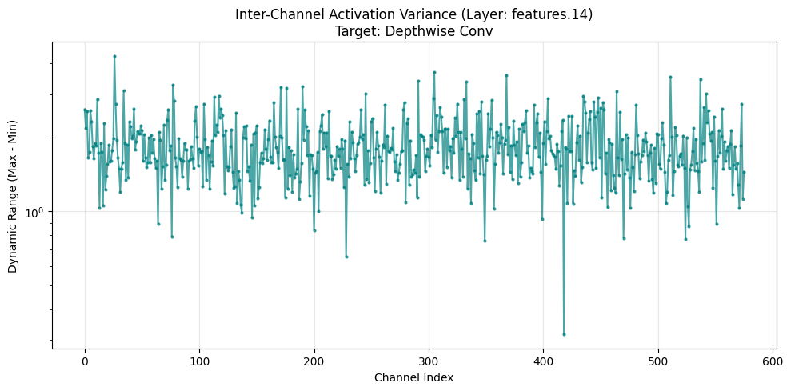
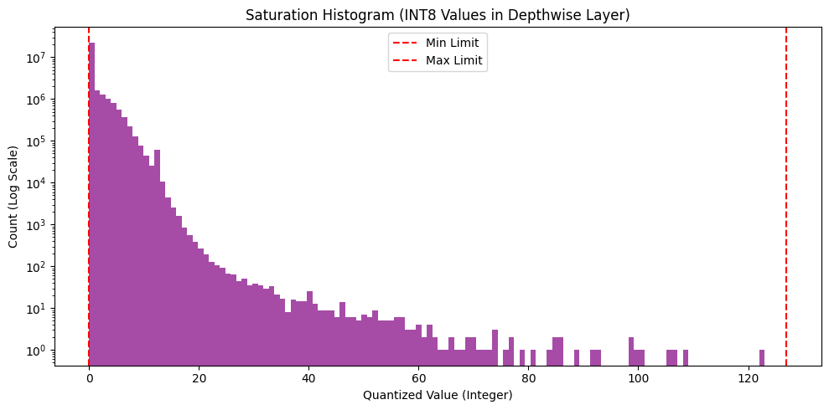
PTQ Experiment: Naive Per-Tensor Quantization
Simplest PTQ method, uses one global scale per activation tensor, giving minimal cost and fastest conversion.
Accuracy drops from 95.49% -> 44.18%, MobileNetV2 is too sensitive for naive per-tensor PTQ
Activation variance plot shows large inter-channel range differences, single global scale cannot represent them.
Saturation histogram (e.g., feature layer 14) shows most activation values collapse to 0, confirming severe information loss.
Notes:
interchannel range each channel shows how wide the values are inside the channel, some channels have very large ranges and some channels have very tiny ranges.
if you use per tensor PTQ the quantizer uses a single scale + zero point for entire tensor (one scale must represent all 576 channels together) which many low range channels collapse into all zeros (per-tensor quantization failure), causing information loss

Slide 10
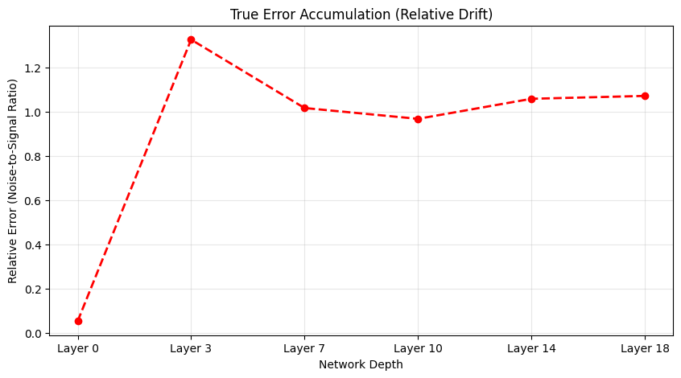
PTQ Experiment: Per-Channel Weight Quantization
Applies independent scales per channel to resolve dynamic range mismatches in weights.
Accuracy recovers to 67.87%, but INT8 features increasingly deviate from the FP32 baseline in deeper layers.
Post-training methods cannot correct accumulated zero-point bias or systemic activation clipping errors.
Per-channel PTQ partially fixes quantization noise, but QAT is required to train the model to learn and adapt to this specific quantization noise.
Notes:
-even with per-channel scaling and even though accuracy improves, error still compounds as the model gets deeper, so PTQ is still not enough.
- dirft = how much the int8 model changese the meaning of the features compared to FP32, high drift means basically destroying the representation, deeper layers are still very different from FP32, meaning activations are very different
-PTQ helps but cannot correct it all because of activation clipping errors, zero-point bias, wrong quantization range
-QAT learns the weights under quantization.

Slide 11
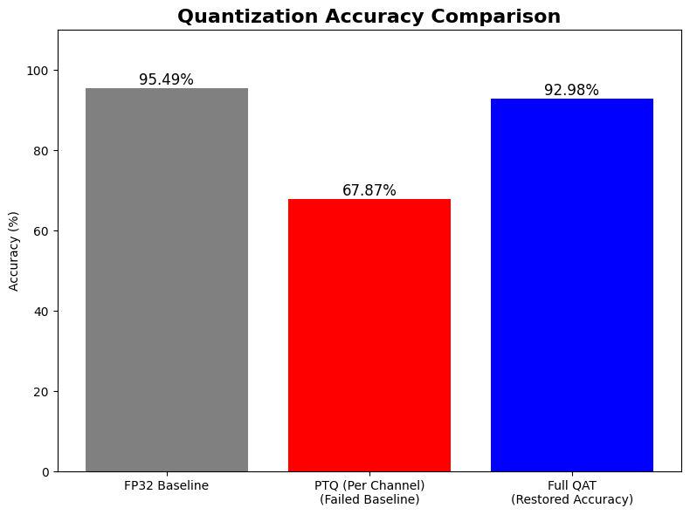
QAT Baseline: Full Model Retraining
Retrained 100% of parameters (~2.2M) using fake-quant modules that mimic INT8 behavior during training.
Restores accuracy to ~93%, eliminating the large activation mismatch observed in PTQ.
Shows letting weights to adapt and learn the quantization grid resolves the structural sensitivity of depthwise layers.
Full QAT is expensive, motivating selective approaches that retrain only most quantization-sensitive layers.

Slide 12
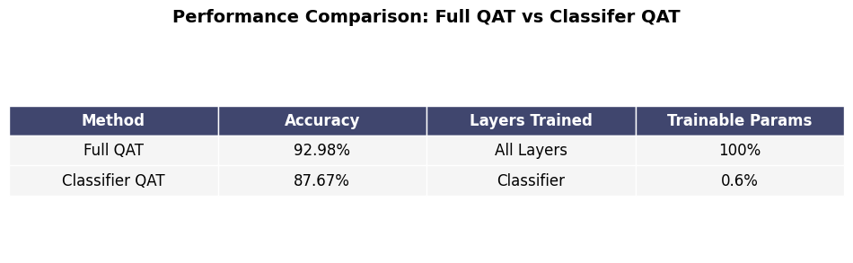
QAT Experiment: Classifier-Only Retraining
Retrained final classifier layer (0.6% parameters) while freezing all convolutional blocks.
Model showed severe instability, final converted INT8 model degraded significantly to 87.67% accuracy.
Demonstrates that quantization errors originate in earlier layers, not in the classifier.
Confirms the need for depth-wise focused retraining to restore MobileNetV2 INT8 accuracy.

Slide 13
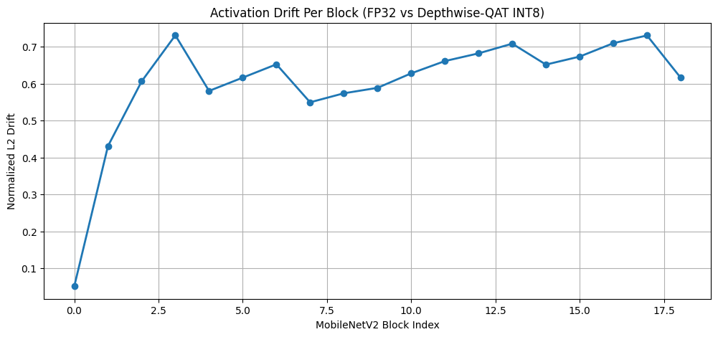
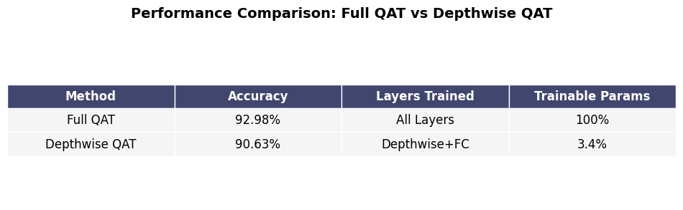
QAT Experiment: Depthwise Retraining
Retrained only depthwise convolutions (3.4% parameters) while freezing all 1x1 pointwise and bottleneck layers.
Converted INT8 accuracy improved to ~90.63%, recovering most of the performance lost under PTQ and outperforming classifier-only QAT.
Directly corrects per-channel quantization drift, stabilizing activation distributions where quantization error is introduced.
Still ~2% accuracy short, drift plot shows persistent high error in depthwise blocks, motivating need to include 1x1 expansion layers for accuracy gains.
Notes:
QAT is designed so that INT8 activations become as close as possible to FP32 activations after training
Drift direct indicator of where QAT is still failing, QAT did not successfully adapt to that location

Slide 14
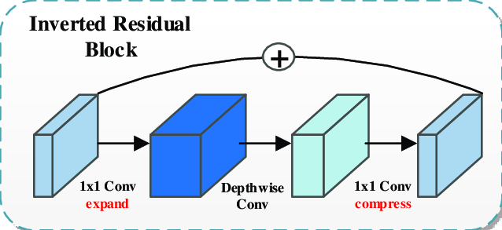
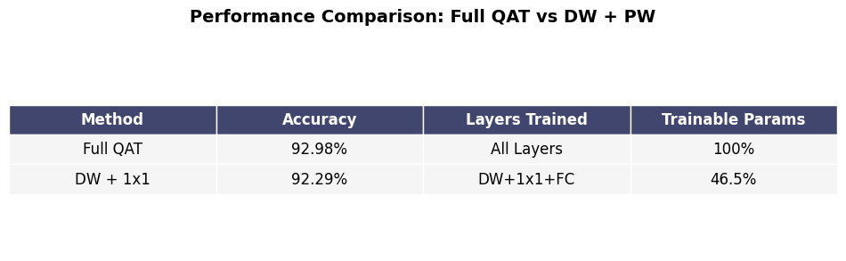
QAT Experiment: Depthwise + 1x1 Pointwise
Expanded training scope to include pointwise 1x1 projection layers (~46.5% parameters) to resolve feature mismatch and instability caused by depthwise shifting.
INT8 accuracy increased to 92.29%, nearly matching full QAT performance while updating less than half the model.
Stabilizes both per-channel and cross-channel activations, eliminating major structural source of quantization drift.
Freeze
Retrained

Slide 15
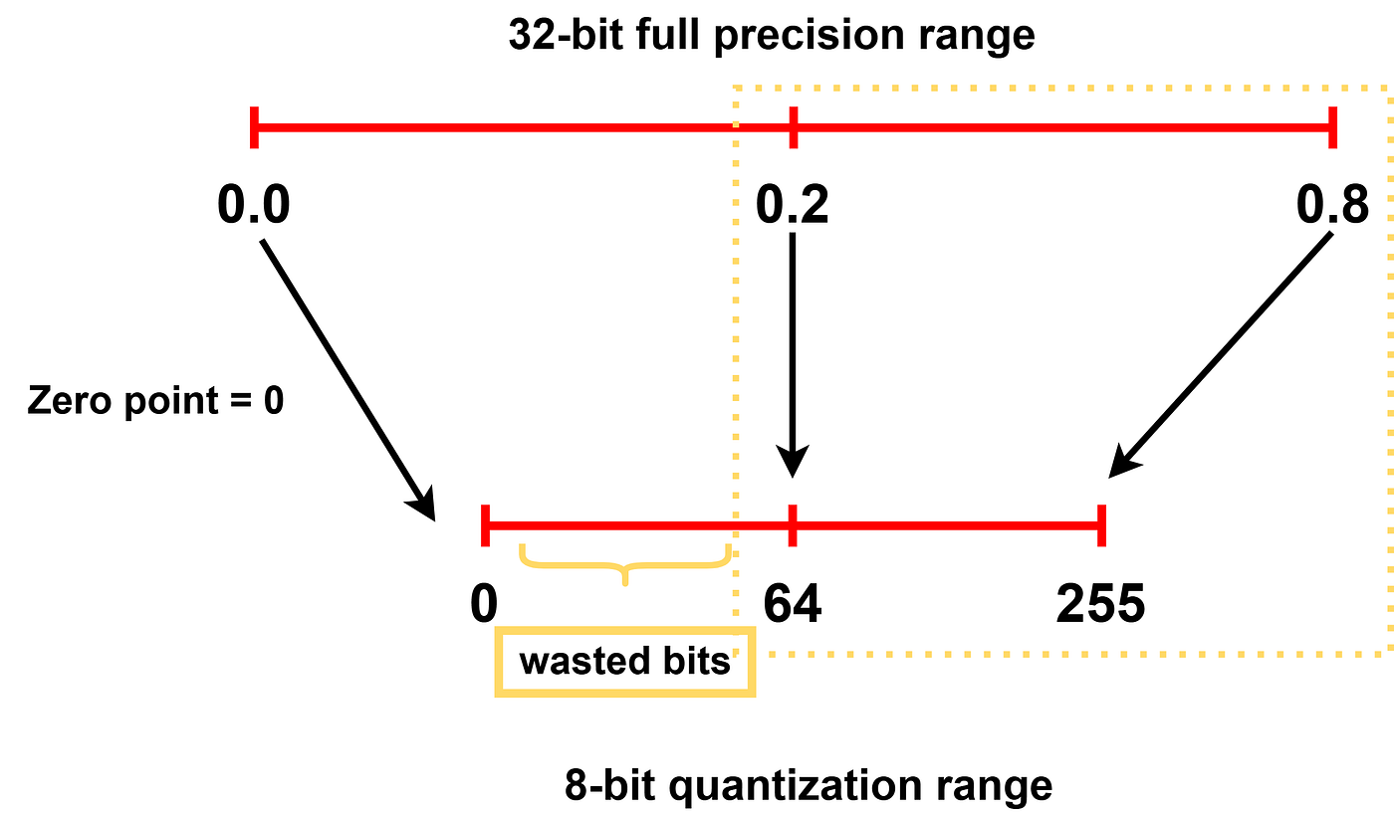
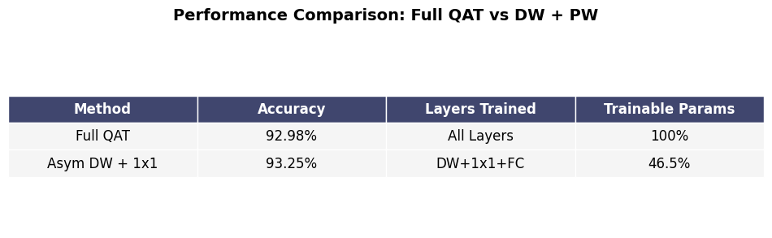
QAT Final Experiment: Asymmetric Depthwise + 1x1 Layers
Switched symmetric to asymmetric activation quantization for depthwise + 1x1 retraining.
Achieved 93.26% INT8 accuracy, higher than full QAT performance while retraining only ~46.5% of parameters.
Better represent ReLU distributions by using the full [0-255] range, reducing clipping and residual drift in bottleneck layers.

Slide 16
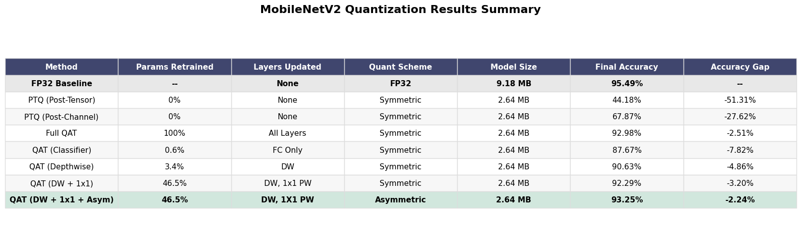
Experimental Results Summary
Notes:
-Highest accuracy with training time being negligible because you do not train that many epochs is 93.80%
- However, if you want to train multiple epochs and it is costly, 40% params retrained is also a good option because u only sacrifice ~0.3% accuracy from full QAT baseline symmetric

Slide 17
Conclusion
MobileNetV2’s quantization errors are concentrated in depthwise and 1x1 bottleneck layers, making standard PTQ unreliable.
Selective QAT on these layers (~46.5% parameters) recovers nearly all INT8 accuracy of full QAT while leaving rest of model frozen.
Asymmetric activation quantization eliminates residual drift in ReLU bottlenecks, achieving 93.25% accuracy, higher than full QAT.
Full model retraining is not required to obtain high INT8 accuracy; targeted QAT at quantization-critical layers is sufficient.

Slide 18
Future Goals and Implementations
Extend layer-selective analysis to MobileNetV3 or EfficientNet-Lite to evaluate whether depthwise and 1x1 bottlenecks remain quantization-critical in modern mobile networks.
Develop automated layer selection methods driven by activation drift metrics, enabling data-driven determination of quantization-critical blocks rather than manual specification.
Explore low-bit INT4/mixed-precision selective QAT to test whether structural sensitivity persists when pushing beyond 8-bit constraints.

Slide 19
References
Aparna, Mudiyala & Rao, Battula. (2023). A novel automated deep learning approach for Alzheimer's disease classification. IAES International Journal of Artificial Intelligence (IJ-AI). 12. 451. 10.11591/ijai.v12.i1.pp451-458.
Lobo Torres, Daliana & Noa Turnes, Javier & Soto Vega, Pedro J. & Feitosa, Raul & e Silva, Daniel & Junior, José & Almeida, Cláudio. (2021). Deforestation Detection with Fully Convolutional Networks in the Amazon Forest from Landsat-8 and Sentinel-2 Images. Remote Sensing. 13. 5084. 10.3390/rs13245084.
Notes:
-MobileNetsV3 uses SE-Blocks which are sigmoid activation functions.
- Sigmoid is a complex curve and very hard to quantize to INT8 without losing precision, mobilenetv3 is even more sensitive

